Slide 1
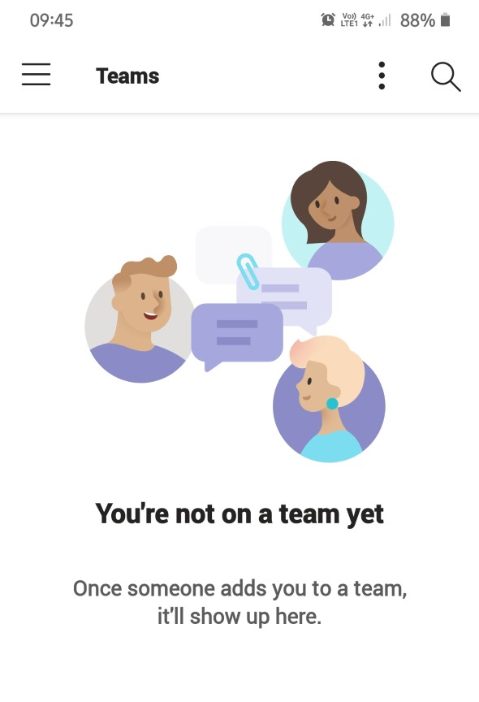
Trouble shooting – what to do if you log on and you see this image instead of your child’s team.
This is what to do if you have joined on phone or a tablet.
Go to the top left corner and click on the three horizontal lines,

Slide 2
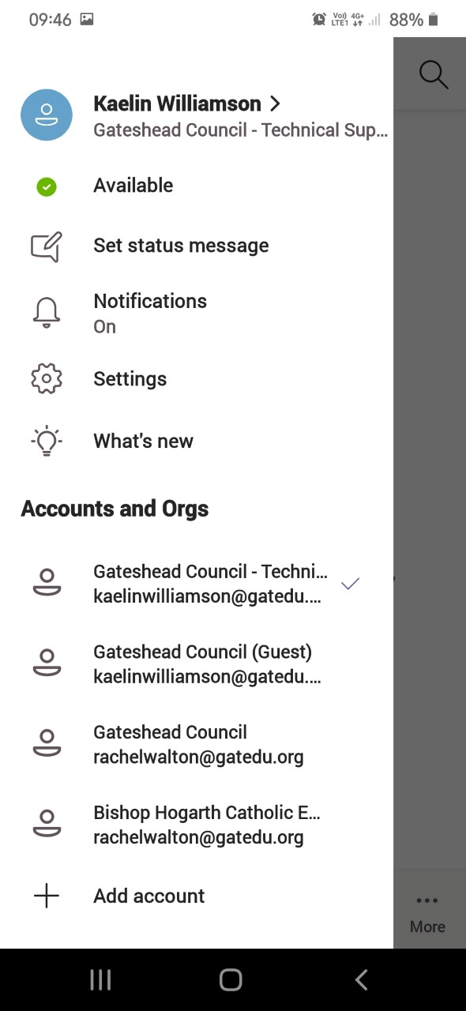
Trouble shooting – what to do if you log on and you see this image instead of your child’s team.
You will see that your child also has a (Guest) account option. Click it.
Don’t worry, we asked for permission to use Kaelin’s account!

Slide 3
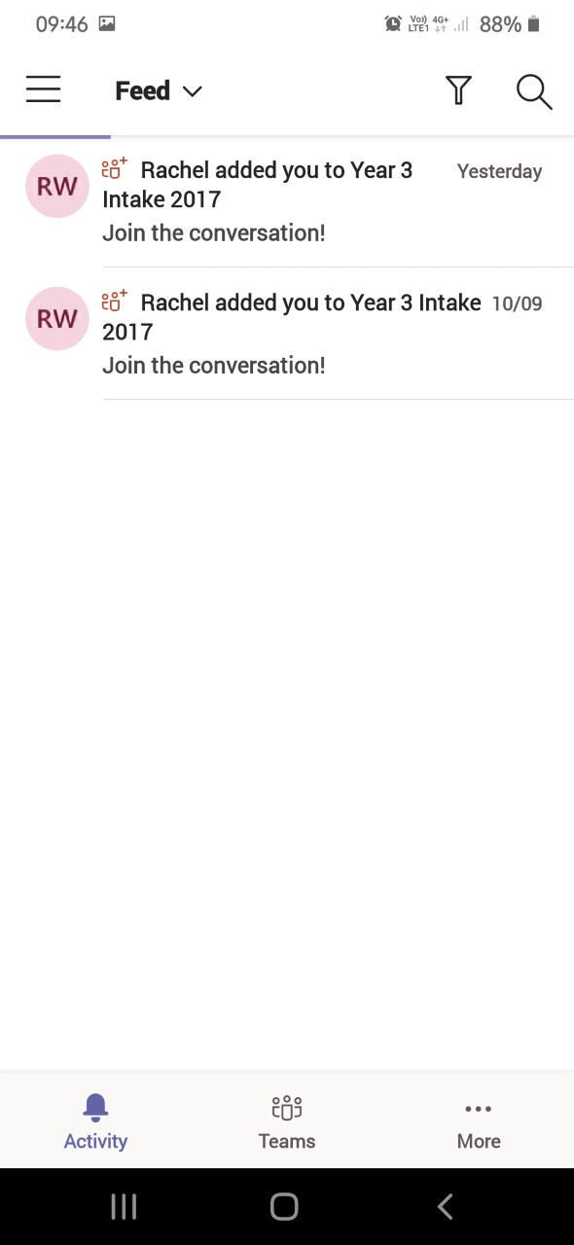
Trouble shooting – what to do if you log on and you see this image instead of your child’s team.
If you see this page, click the icon at the bottom for the team.

Slide 4
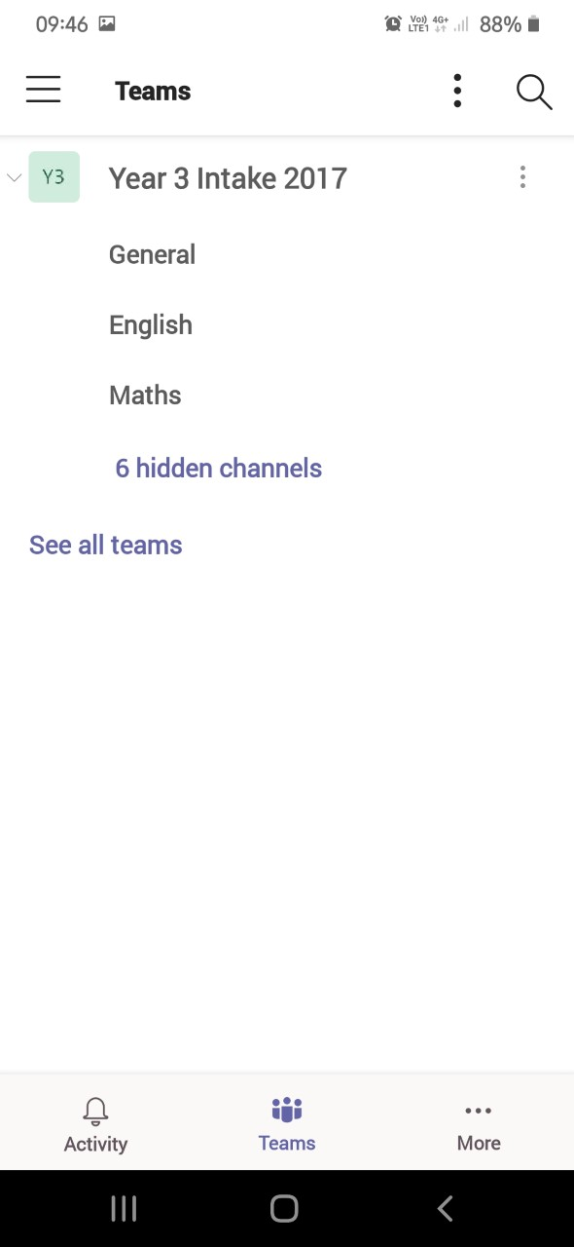
Trouble shooting – what to do if you log on and you see this image instead of your child’s team.
You are now on your child’s team. Click General to take you to the chat your child’s teacher has begun and give them a wave or a hello.

Slide 5
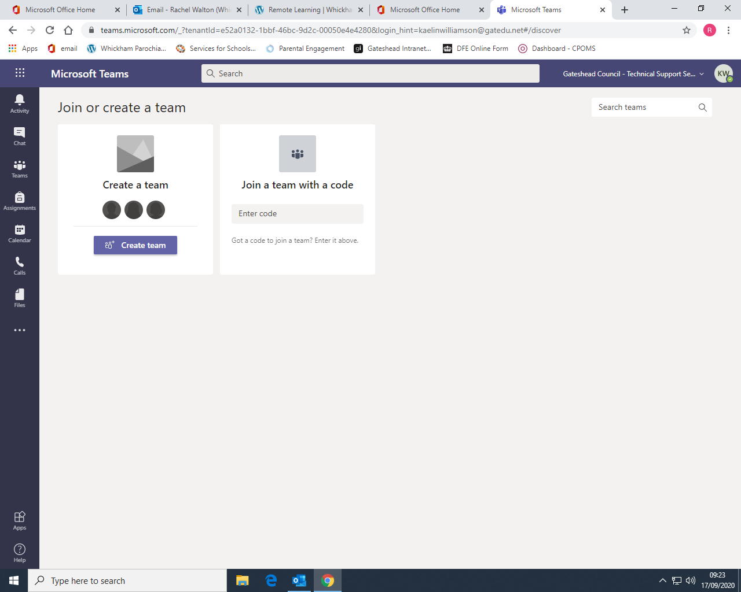
Trouble shooting – what to do if you log on and you see this image instead of your child’s team.
This is what to do if you have joined on web browser.
Go to the top right hand corner where your child’s initials are in a coloured circle. Just beside it you will see the beginning of the phrase Gateshead Council Technical Support.
Click the phrase.

Slide 6
Trouble shooting – what to do if you log on and you see this image instead of your child’s team.
This will appear. Click the (Guest) option.

Slide 7
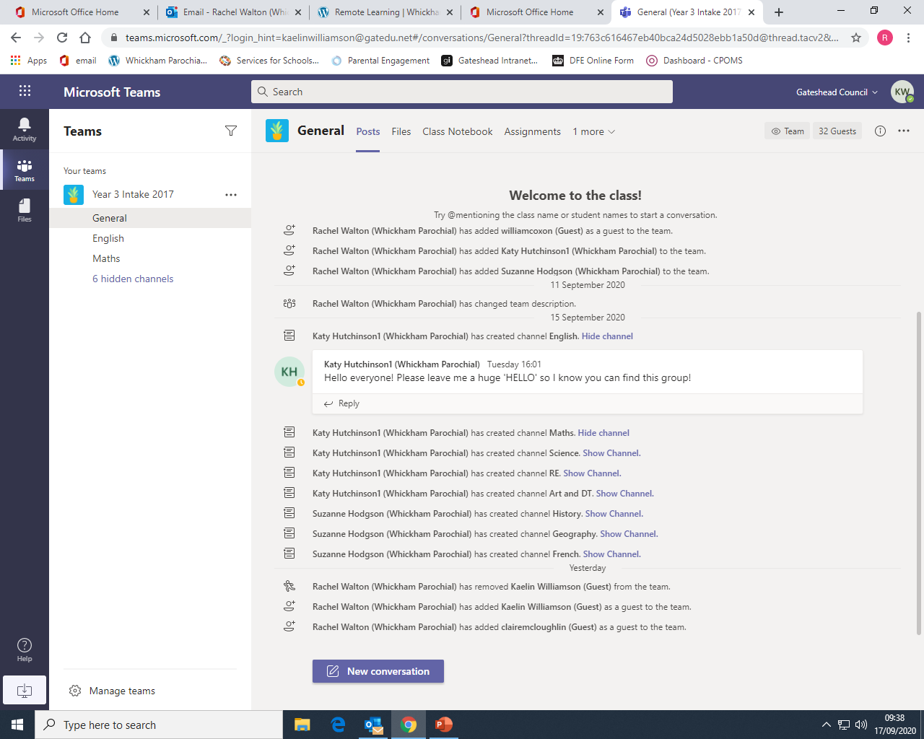
Trouble shooting – what to do if you log on and you see this image instead of your child’s team.
The team is now visible. Look to find the message your teacher has written and reply with a hello so we know you have managed to access the team.

