Slide 1
Reception
At Whickham Parochial C of E Primary School

Slide 2
Daily Routine
Dinner choice and empty black folders
Sit on carpet with white boards for morning task
Notice board and daily news – ‘Good Morning’ song, days of the week, visual timetable
Phonics
Break time
Mathematics
Lunch
Topic or Plan, Do, Review
Story time

Slide 3
Weekly overview
Monday | Guided reading Homework and reading books to be returned
Tuesday | Mathematics activities Homework and reading books handed out
Wednesday | PE Forest school Plan, Do, Review
Thursday | Guided write
Friday | RE

Slide 4
Reception curriculum

Slide 5
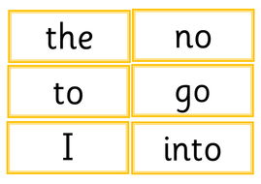
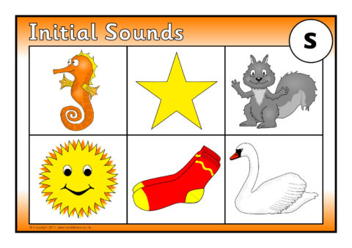
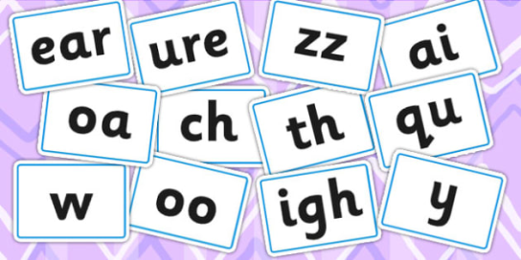
Phonics
Recap sounds taught so far using flash cards
Introduce new sound- show pictures, show sound, action, song, letter formation
Oral blending – robot a word and children blend
Show flash cards again including new sound
Read it – ‘Look at the letter, make the sound, blend the sound
together’
Write it- ‘Say it, robot it, write it’

Slide 6
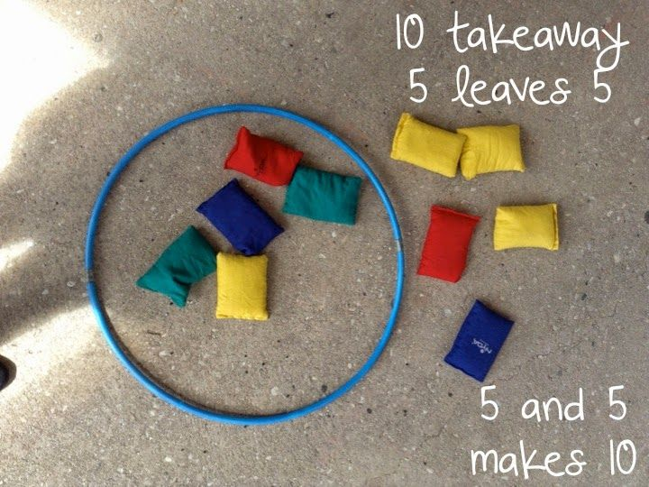
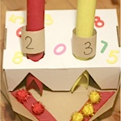
Mathematics
Rapid recall at the start of each session
Practical mathematical understanding in the Foundation Stage is
developed through stories, songs, games and imaginative play, in
which children are given the opportunity to gain knowledge and skills in number, measure, pattern, shape and space.

Slide 7
Helping at home - Maths

Slide 8
Homework
Not compulsory but supports what we have been doing in class
Use blue homework book but this does not need to be returned
It is not marked just stamped to say we have seen it
We will file it in your child’s file
Goes home on a Tuesday and to be returned on a Monday

Slide 9
Supporting Early
Readers
The beginning of a child's journey into reading is so important and has already begun
long before they start their Reception year. Sharing a story, discussing pictures,
predicting what might happen and why are vital skills. It is for this reason that the first
book your child will bring home from school will be a wordless book. Your child (and
you!) may be disappointed not to be 'reading', as in decoding written words, but in fact
they will be practising skills that will support them throughout their reading journey
with us
https://childrenslibrarylady.com/why-are-wordless-picture-books-important/?fbclid=IwAR2PAA5VE6G5LxJbDKt97JKcP3kCxuR5gFtzHE0hxo5icy57hUcaeHbkWdM

Slide 10
When you first get a book:
Help your child to know the letters and sounds they practise at school in every
aspect.
Use correct pronunciation to help when your child is ready to blend, say t not ‘tuh’ (don’t add the schwa).
Letter Sounds (phonics)

Slide 11
Hand your child the book the wrong way round.
Let your child hold the book when you read to him.
Don’t turn the pages for them, let them get used to doing this.
Ask your child – “where should I start to read?”
Conventions of Print
Notes:
First three are surprisingly hard to get used to, but it helps with directionality.
Sweep your finger across the print. If they cant tell you where to start, get into habit of saying we start up here and pointing.

Slide 12
You will notice that there are some words which cannot be sounded out, for example ‘once’ and ‘the’. These words are tricky words, and we need to know them because they appear frequently in reading.
To support your child in recognising these words, write them down and then put them on flashcards. Play ‘my pile, your pile’ or ‘Quickwrite’.
Common (tricky) words
Notes:
These are words that children just need to know – you will find a spaced for them in the Look what I know sheet.
Explain my pile your pile and quick write.
Letters on the fridge are very good for this.
Again, if they use them in independent writing – huge fuss.
Children develop a bank in their brains of word I cant sound out – you’ll know when they’ve got it because theyll come across a common word and they will guess – dont panic when this happens!
12

Slide 13
Ask – “What is this book about?” Point to relevant words in text.
Make obvious mistakes linked to meaning, then ask how they know when they correct you.
If they know an initial sound, use this as evidence of their correct answer.
Text is linked to content
Notes:
Children need to have it made explicit that the print relates to the meaning of the book – by meaning we mean the story he hears and the pictures he sees. So when he points to something in the book and talks about it – say “Yes heres the word – I can tell cos it starts with a __”
They will love it when you make mistakes – make them linked to pictures at first. They will correct you – praise them for it and ask them how they knew – they will probably say from the picture – which is fine – but them take them to the words and say something about the way it looks – for example – yes dog is a little word and this is a long word – so it must be elephant or initial sound.

Slide 14
At Points of Error or Refusal
This is the point at which you can be most
effective.
This is the part where your reaction can help your child to make the leap into
understanding the otherwise implied facts
about how text works.
Notes:
Ask what parents do at point of error – reassure them that these are good strategies for most children to help them get to that word, but if we use the following strategies, we will be teaching them the way that text works and giving them their own strategies to problem solve unknown words.
This next bit has a very big impact on reading – but it is a subtle difference to what you have always done however -
Extra reading on its own will not help a struggling child - Sports saying “if you do what you’ve always done, you get what you always got!”
14

Slide 15
Common errors:
Saying letters then moving on without blending.
Sounding out, then guessing at a word that is not
linked to the book or the sounds.
Guess at a word based on the content, without applying any sound knowledge (sometimes even
when they have sounded out the first letter!)
Notes:
Children who pick up reading easily are using their sounds in conjunction with lots of other information, they know that letters make real words, they know that the words will be linked to the story, and they know that the sentence will make sense and that the words go together in a particular order. A child who doesn’t make these connections will make these mistakes.
15

Slide 16
Cross Checking
At points of error:
“Could it be that?”
“Use the sounds to help you.”
“Would that make sense in sentence?” or, “do we
usually say it like that?”
“Does it match the sounds?”
“Would that fit in the story?”
Notes:
Show the prompts from Literacy lessons part 2 p203.
16

Slide 17
One study showed that a high achieving child sees 20,000 words of text in his first year of school, in comparison with a less able reader who sees less than 500 words!
Read aloud to your child as much as you can!
Notes:
17
Introduce love of reading – mention why we do this and emphasise that this is in addition to hearing reading – which is about consolidating learning at the child’s level, and more about love of books, development of imagination, development of narrative language.

Slide 18
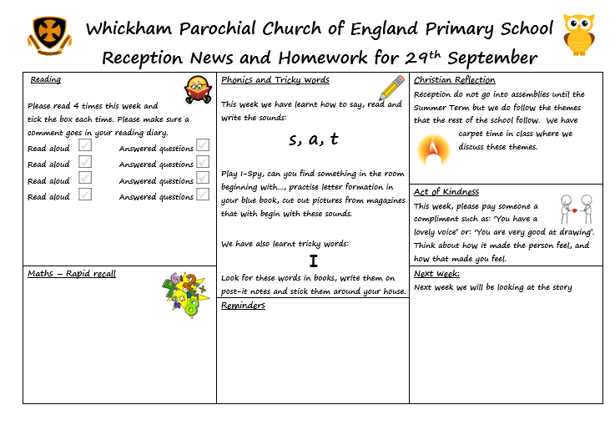
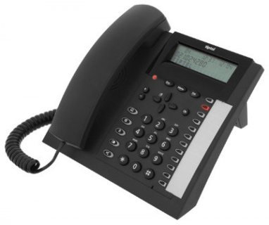
Home school links
Twitter
@parochialschool
Evidence Me
Weekly updates from school.
Please send us ‘Wow’
moments.

Slide 19
Reminders
Please could school folders be sent into school every day and emptied every evening. Apart from packed lunches and Little Kickers clothes, no other bags should come into school.
Water bottles will be sent home every day and to come back filled
Named PE kits to be in school after October half term

Slide 20
Thank you
Any Questions?

